Slide 1
Linking ABS Research Permit Systems with Monitoring under the Nagoya Protocol
Paul Oldham, ABS Initiative &
United Nations University, Institute for Advanced Study of Sustainability (UNU-IAS).
Kenya IT Permit System Validation Workshop
Maanzoni Lodge, Kenya, 26th April 2017

Slide 2
The Nagoya Protocol
Under the Nagoya Protocol Parties must establish national legislation on ABS.
Parties must also facilitate access to genetic resources including a permit (Art. 6) linked to ABS agreements;
ABS agreements take the form of contracts setting out Mutually Agreed Terms on benefit-sharing;
Based on the above, regulators in other Parties will assist with addressing user compliance;
Monitoring (Art. 17) is key to ensuring compliance and building trust;

Slide 3
The capacity to know
One of the key challenges on compliance and monitoring is the capacity of governments to know what is happening with GR and TK;
There is an important link between Article 6 and Art 17 on monitoring. And, as I will suggest, to benefit sharing;
Permit systems provide the key starting point for implementing ABS and monitoring compliance;

Slide 4
Online permitting
Electronic permit systems needs to do quite a number of things:
1. Simplification for Permit Authorities and Applicants
2. Legal certainty (obligations & requirements)
3. Promoting trust
4. Enabling benefit sharing (monetary & non-monetary)
5. Facilitating monitoring on the ground and when resources move to collections etc
6. Facilitating reporting (NP but also national STI type indicators)

Slide 5
Challenges
Recognising and adapting to what already exists where possible & national needs
Capacity (technical) and sustainability (maintenance)
A permit system has a time horizon of decades = a need for robust & inbuilt redundancy and investments in human capacity

Slide 6
The Proposal
1. A Single Shared System (but multiple authorities)
2. Identifiers and labels (monitoring)
3. Monitoring (local and national)
4. National Reporting
5. Simple and Easy to Use

Slide 7
A Single System: The Concept
A single electronic permit system that makes it easy to apply for permits and for government authorities to review and approve applications, monitor compliance and report on the access, benefit-sharing, compliance and reporting provisions of the Nagoya Protocol.

Slide 8

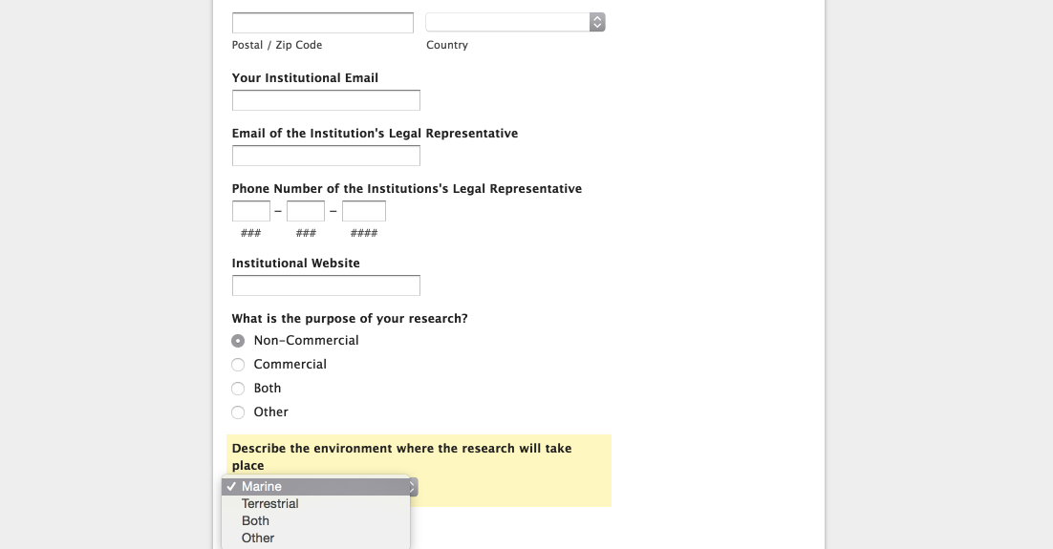
A Single System uses a Simple Web Form
The Single System is based on a simple dynamic web form that triggers actions including notifications.
The system uses a web form with choices, such as the environment where research will take place. Choices trigger actions (pathways) and notifications to authorities.

Slide 9
Electronic Permit System: Core Components
Authorities
Online Front Page
Applicants
Core System
Legal
Backups
Monitoring
Physical Archive
Reporting
Mobile access

Slide 10
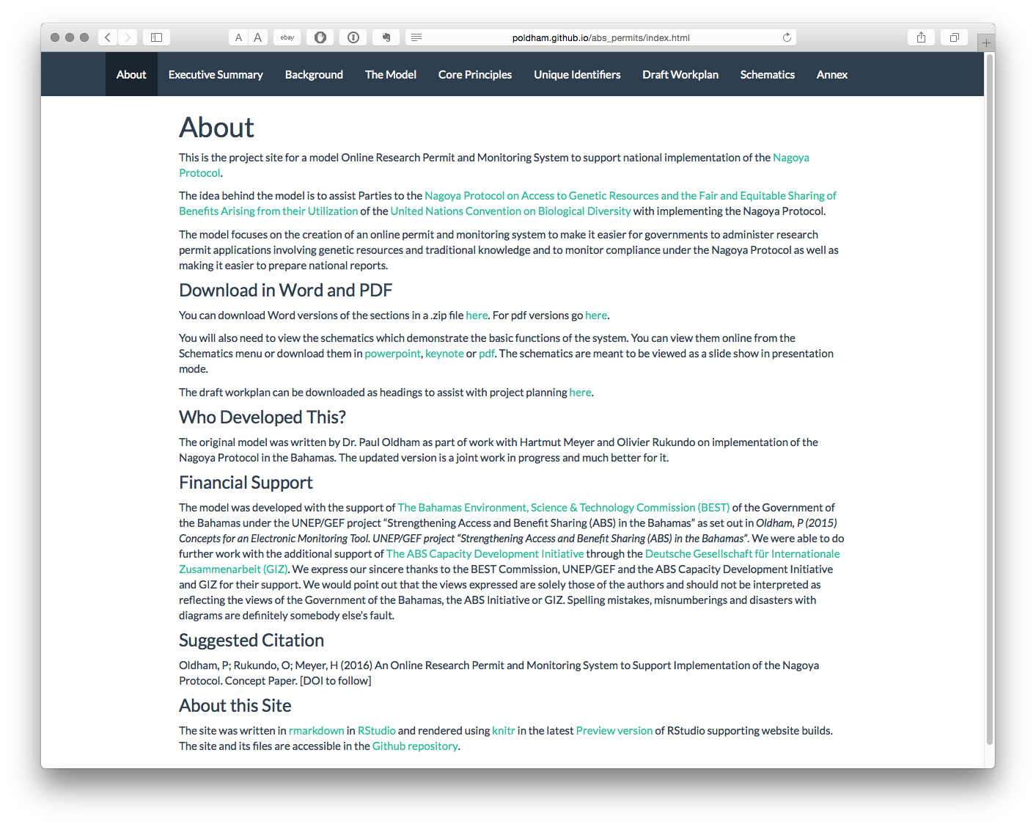
Model online ABS permit and monitoring system
http://poldham.github.io/abs_permits

Slide 11
Applicants
(illustration of applicants section)

Slide 12
Applicant Portal
1.1 Applicant guide
1. Information
1.2 Applicant checklist
2. Applications
3. Notifications
4. Approvals
5. Reporting
6. Appeals

Slide 13
Applicant Portal
1. Information
2.1 Non-commercial
2. Applications
2.2 Commercial
3. Notifications
2.3 Both
4. Approvals
5. Reporting
6. Appeals

Slide 14
Applicant Portal
1. Information
2. Applications
3.1 Receive Notifications
3. Notifications
3.2 Respond Notifications
4. Approvals
5. Reporting
6. Appeals

Slide 15
Applicant Portal
1. Information
2. Applications
3. Notifications
4.1 pdf permit
4. Approvals
4.2 Mobile pass
5. Reporting
4.3 Sample labels
6. Appeals
4.4 HTML embed code

Slide 16
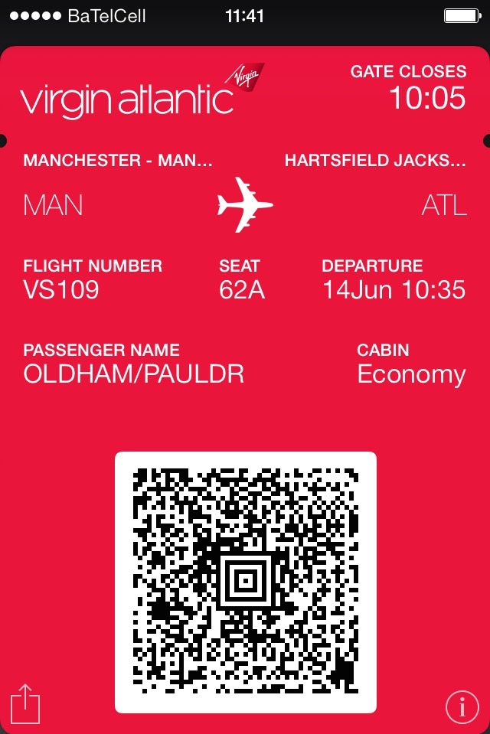

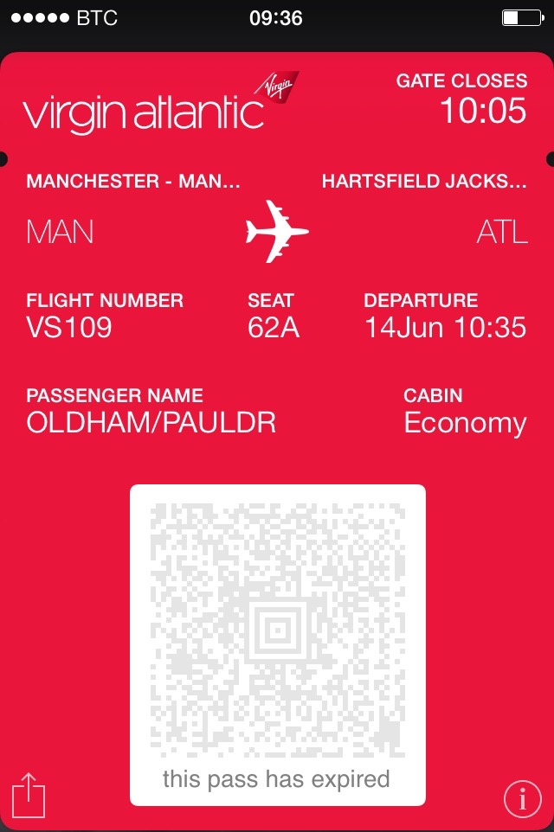
A model for a smart phone pass and sample label (encrypted, time limited)

Slide 17
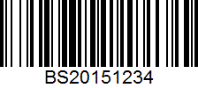
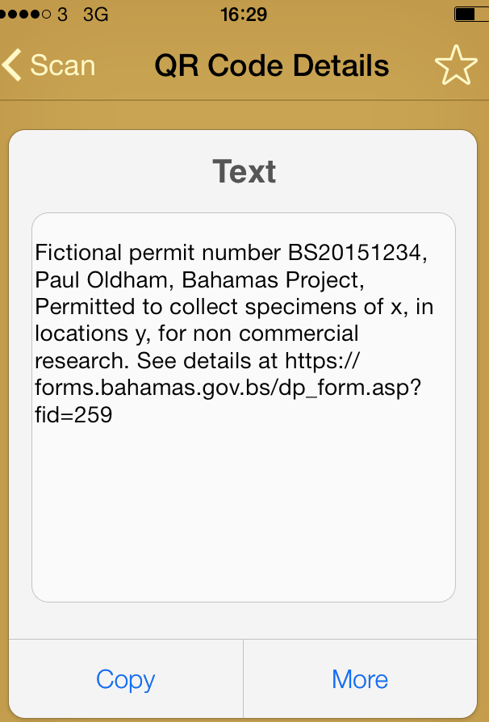
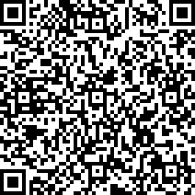
ABS details in the QR code for use in on the spot checks and sample labels for collections
Quick Response Code

Slide 18
Applicant Portal
1. Information
2. Applications
3. Notifications
4. Approvals
5.1 Publications
5. Reporting
5.2 Patents
6. Appeals
5.3 Products

Slide 19
Applicant Portal
1. Information
2. Applications
3. Notifications
5.1 Guidance
4. Approvals
5.2 Timeline
5. Reporting
5.3 Notifications
6. Appeals
5.4 Final Decision

Slide 20
Monitoring GR & TK
Three relatively easy targets and other more difficult targets in terms of monitoring:
1. Taxonomic Data (GBIF)
2. Scientific Literature (commercial databases such as Thomson Reuters Web of Science or open access sources such as crossref, Biomed central).
3. Patent literature. Large scale text mining of patent data.
4. Sequence data (Genbank, Barcode of Life database - 25,000 entries for Kenya)
5. Product information (market approvals)
6. TK related (issue of data sources and methods)
https://poldham.github.io/abs/index.html

Slide 21
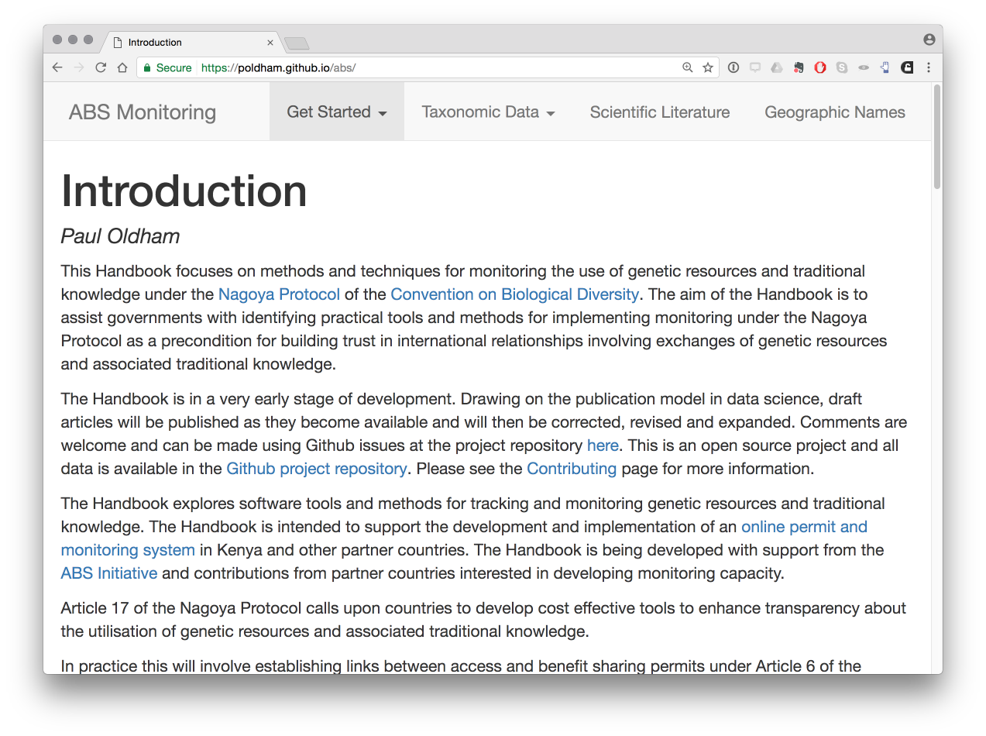
Draft Handbook on ABS Monitoring using data about Kenya for CBD COP14
https://poldham.github.io/abs/index.html

Slide 22
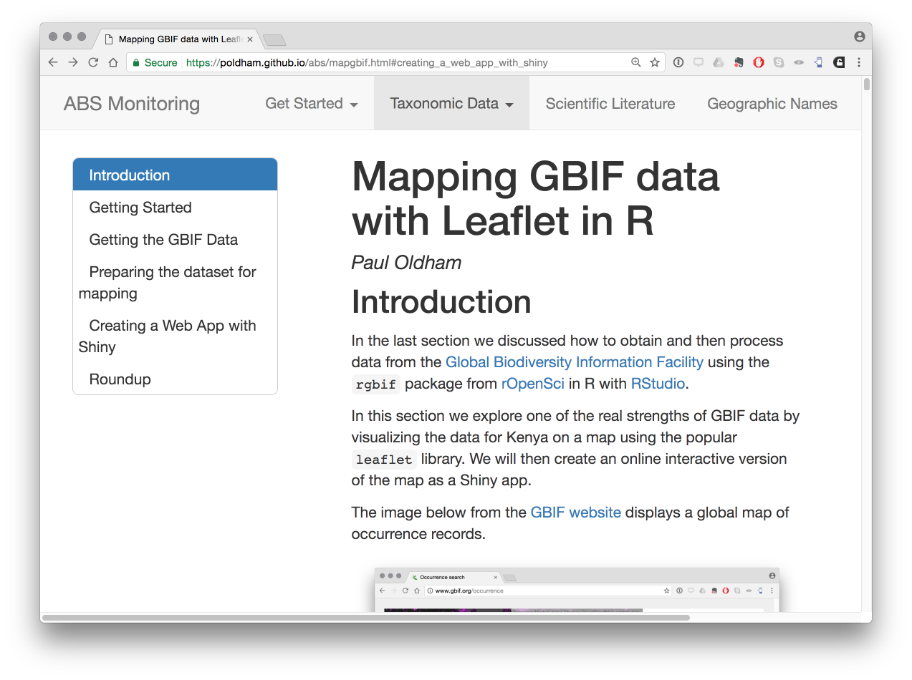
https://poldham.github.io/abs/index.html

Slide 23
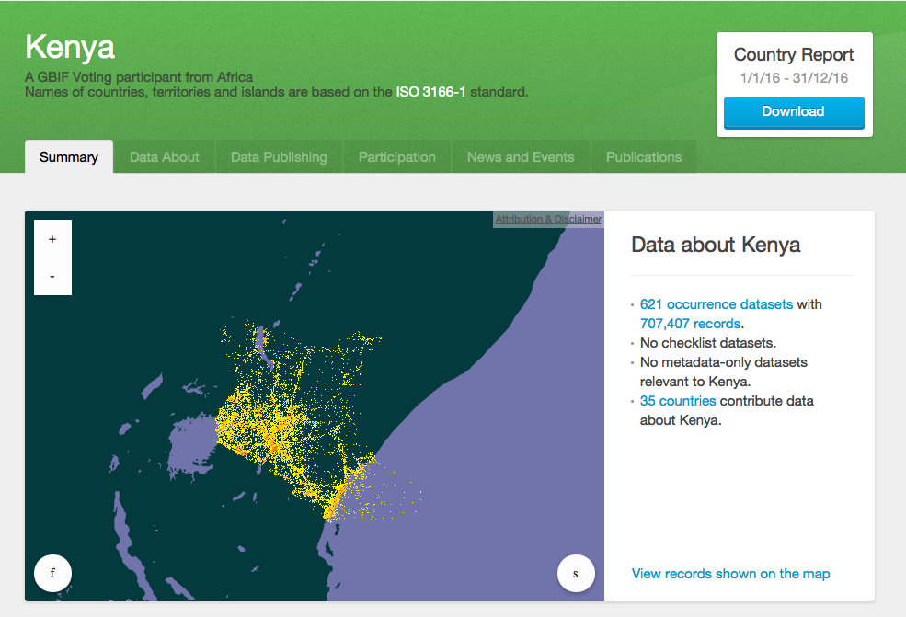

Slide 24
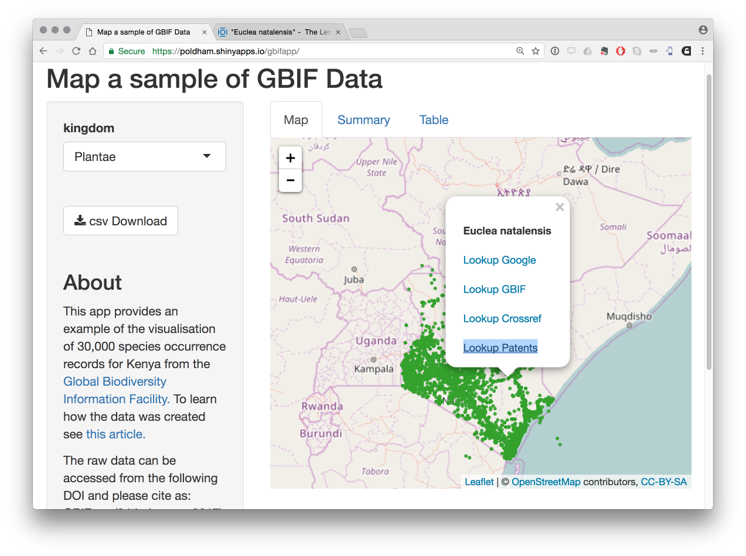
https://poldham.shinyapps.io/gbifapp/

Slide 25
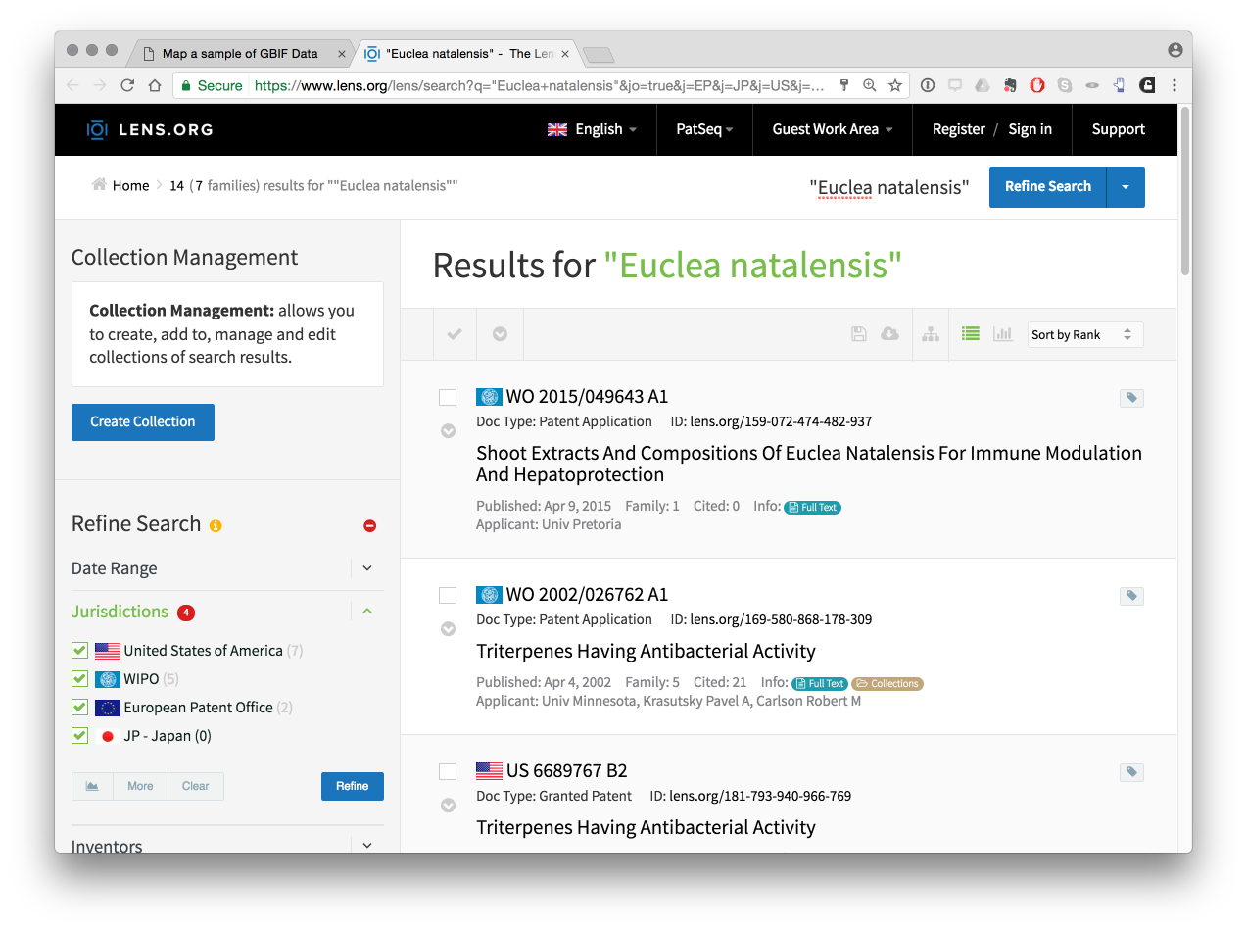
https://poldham.shinyapps.io/gbifapp/

Slide 26
https://poldham.shinyapps.io/gbifapp/

Slide 27
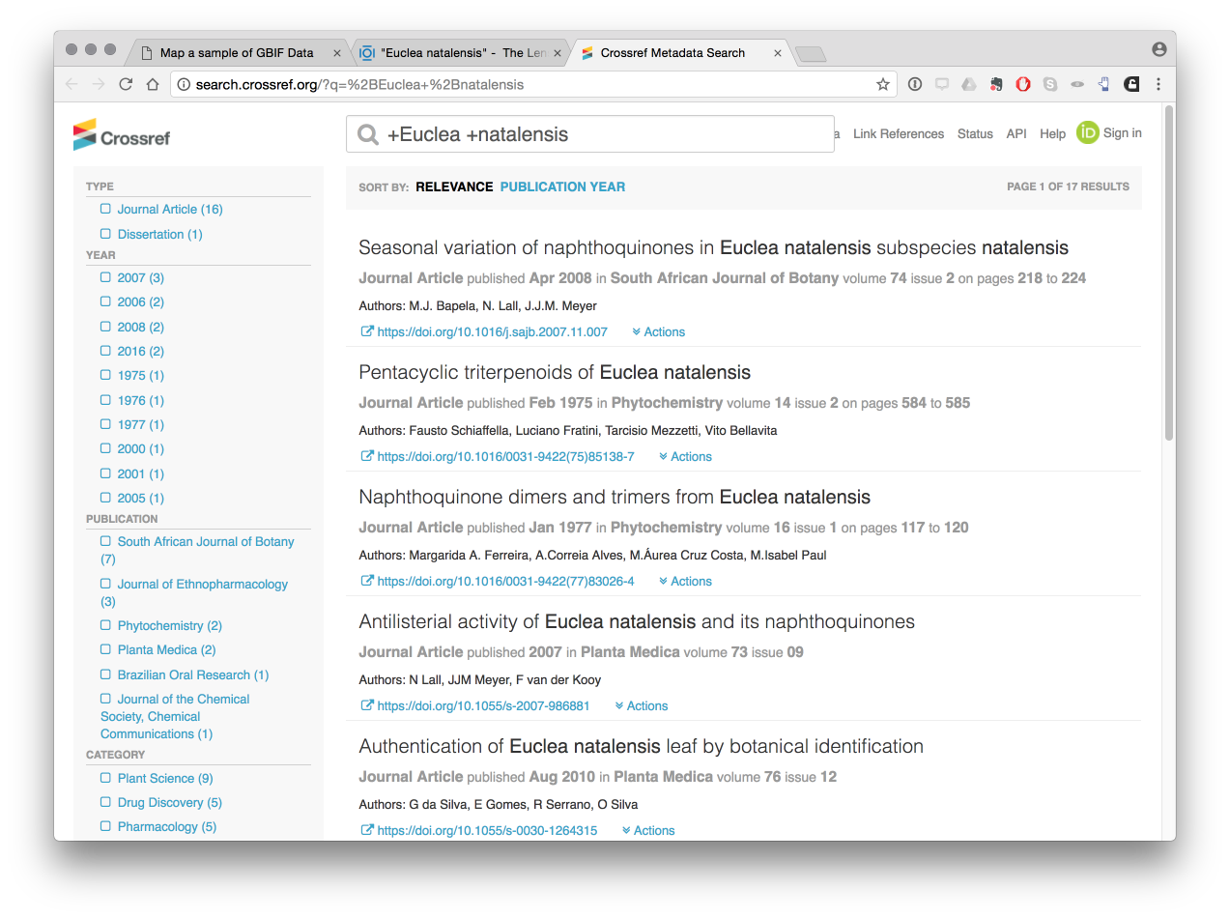
https://poldham.shinyapps.io/gbifapp/

Slide 28
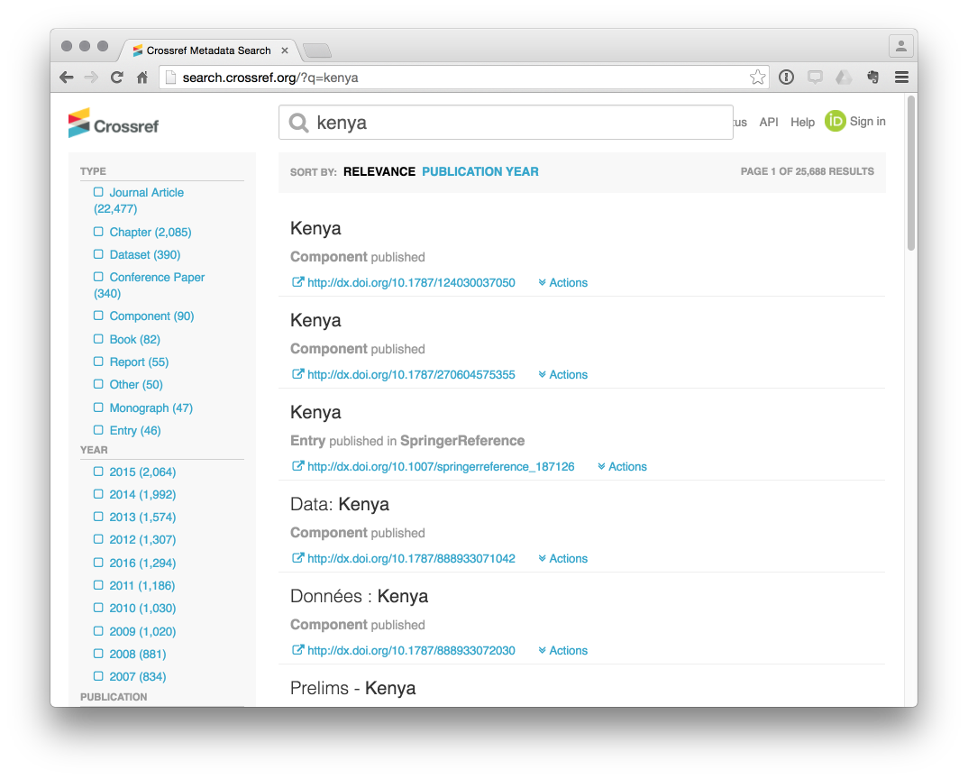
Crossref provides access to over 22,000 publications about Kenya

Slide 29
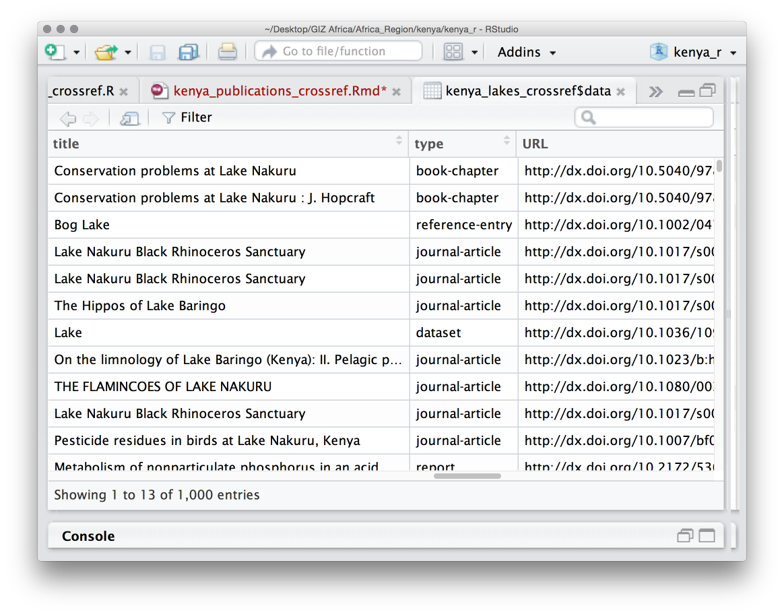
Downloading crossref with rcrossref package in RStudio

Slide 30
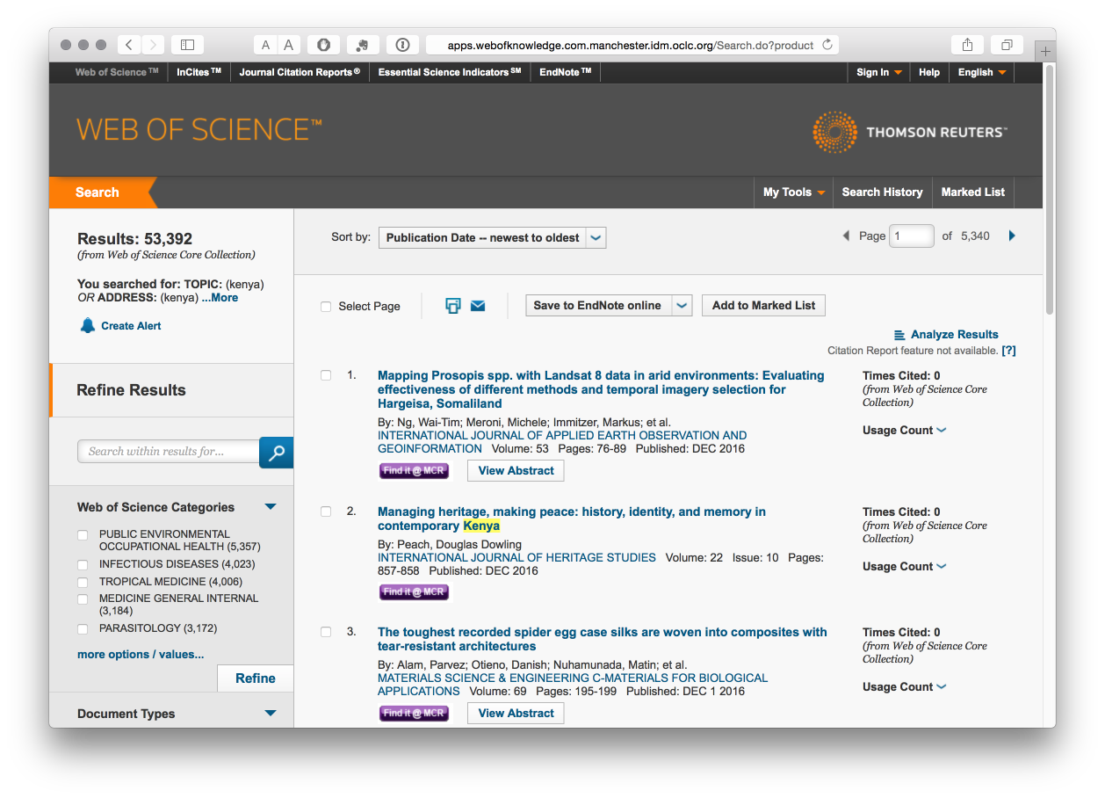
Kenya in the commercial Web of Science Database

Slide 31
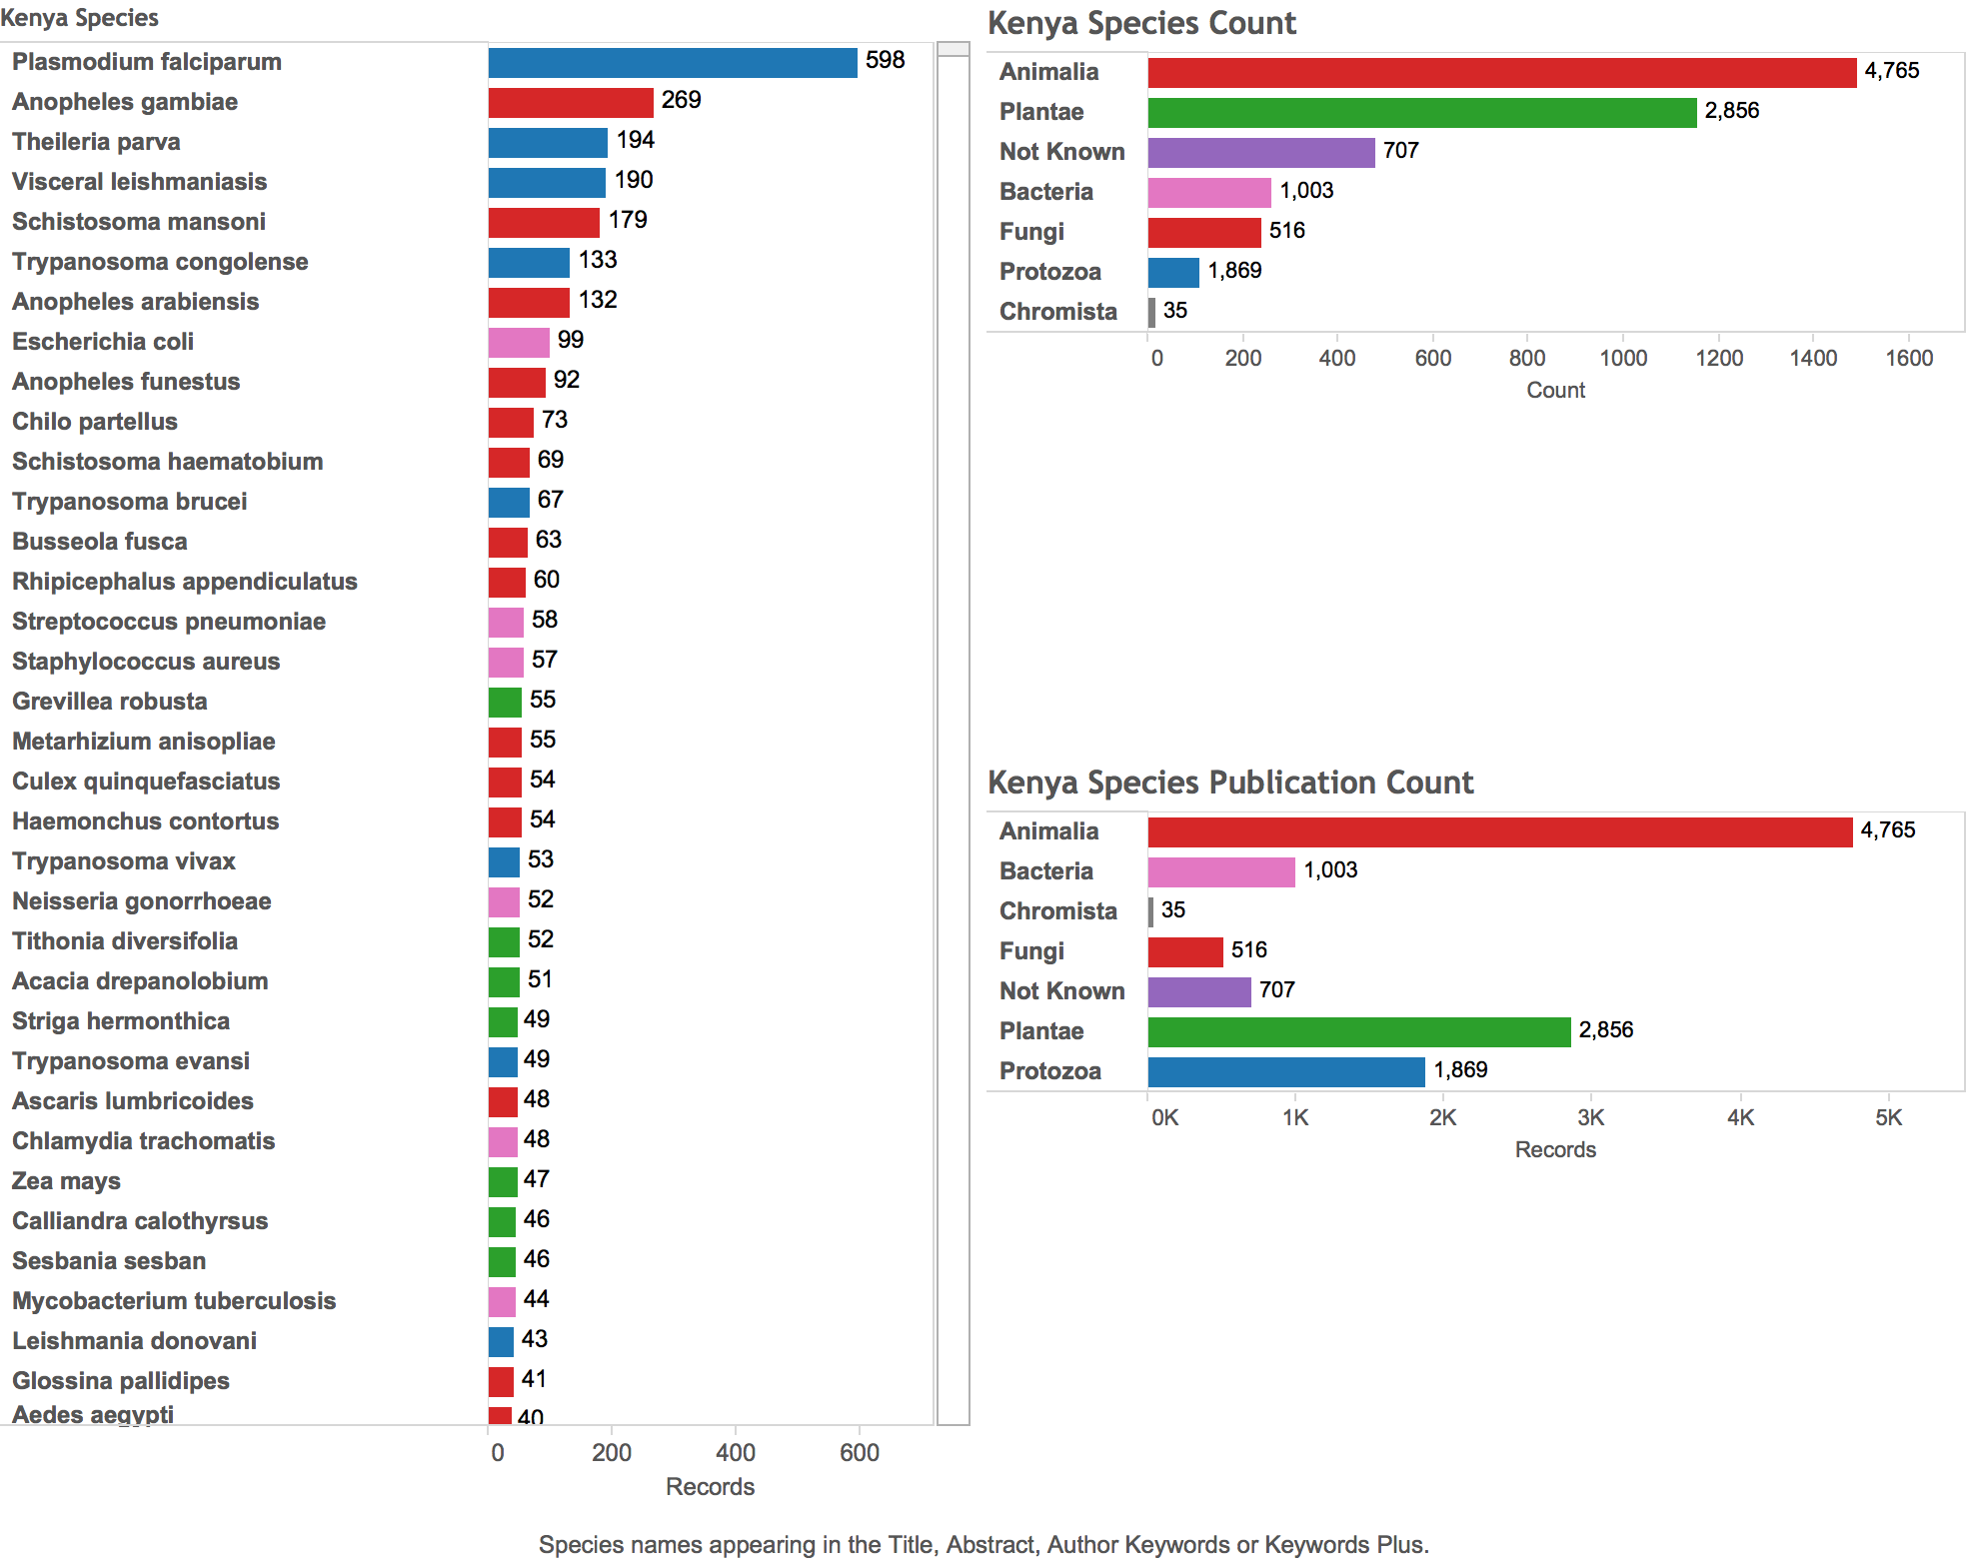
Kenya. Approx 3,752 species in the scientific literature.
See: http://public.tableau.com/profile/poldham#!/

Slide 32
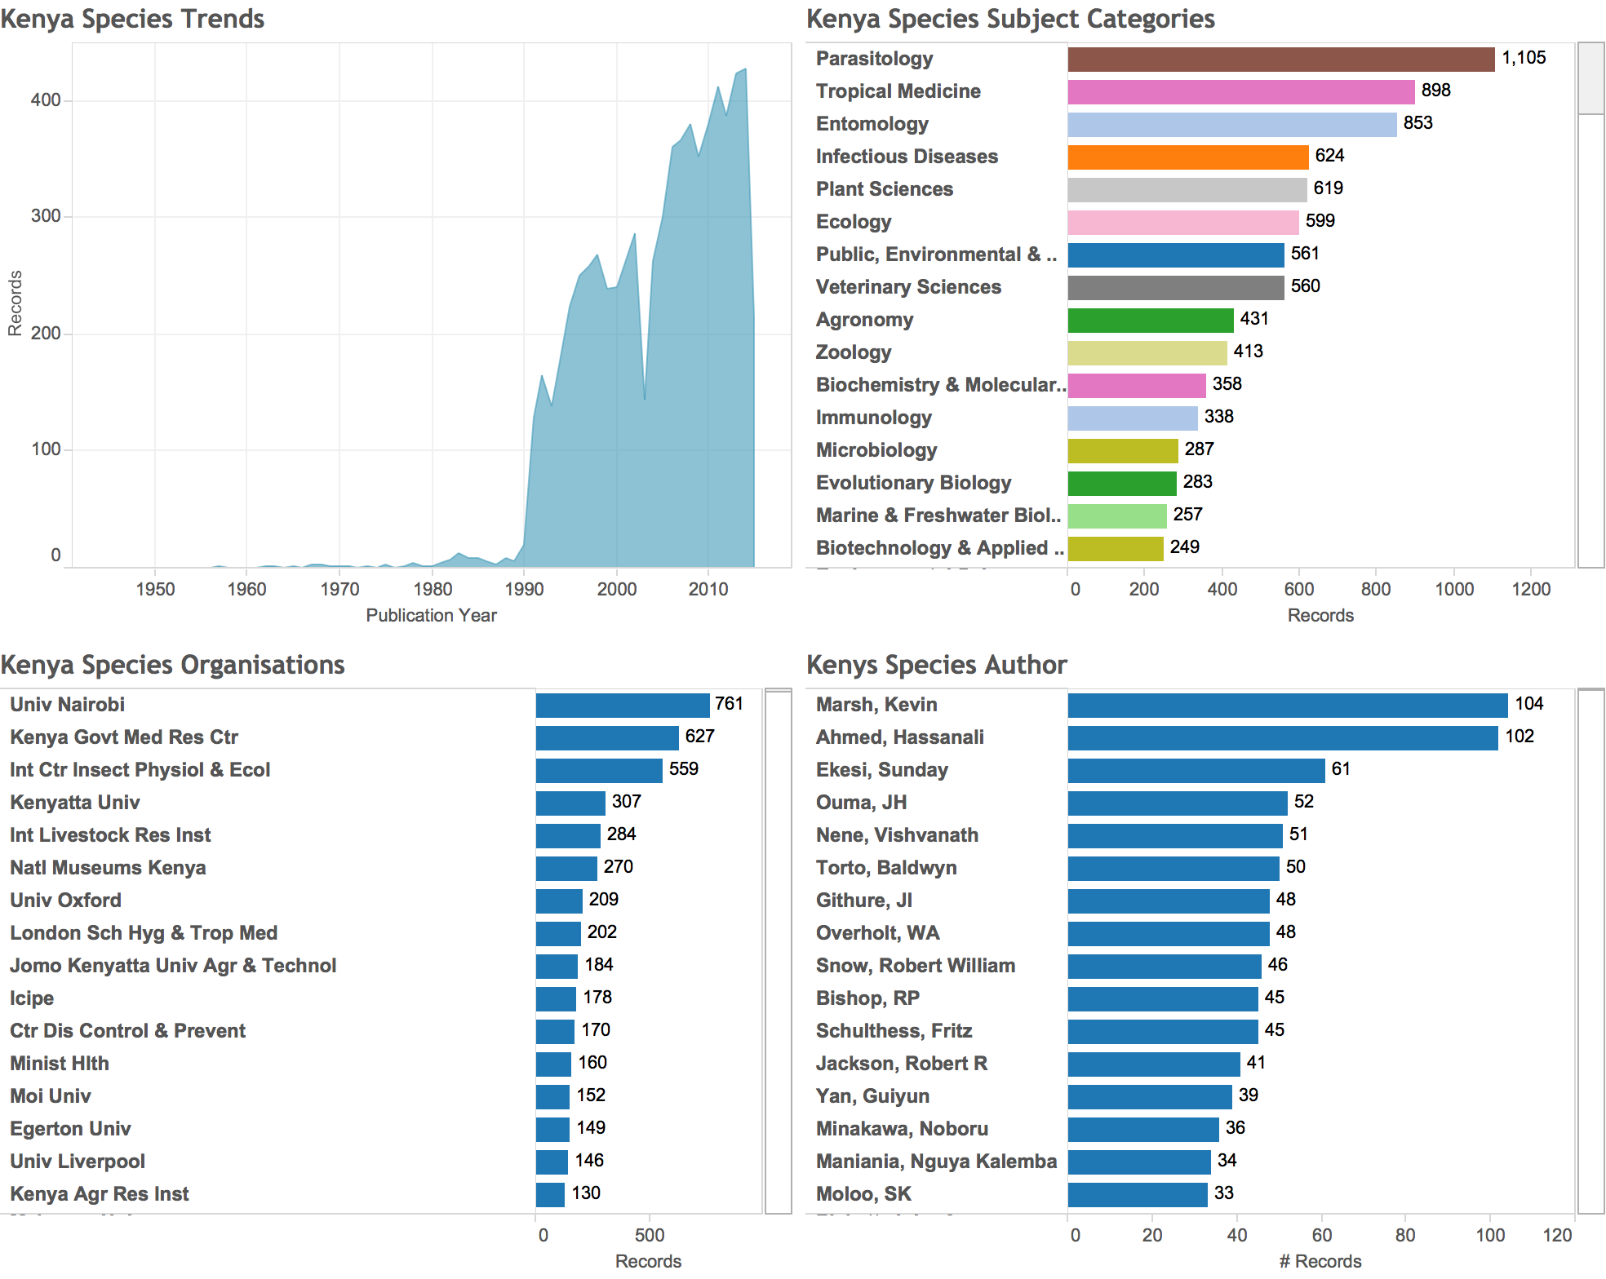
Kenya. Trends in species related publications, subject areas, organisations & researchers

Slide 33
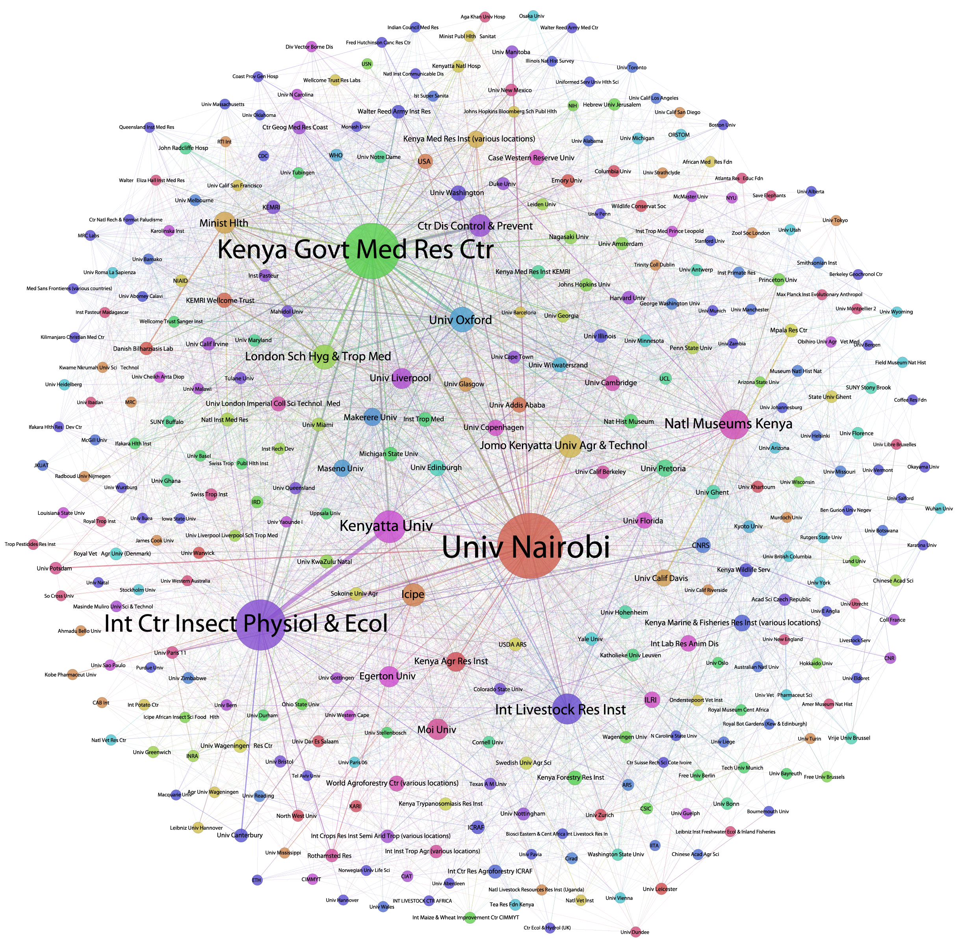
Organisation network researching GR & TK in Kenya. Nodes = No. publications. Lines = co-authorship links

Slide 34
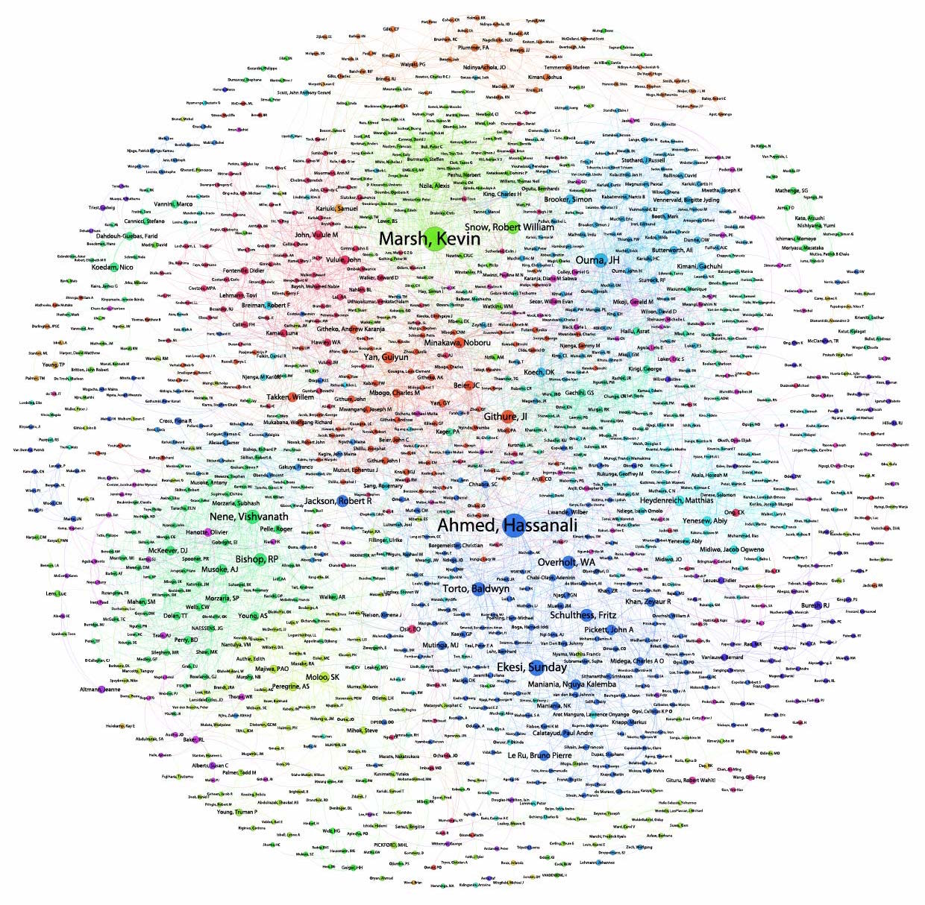
Author Network in Kenya. Nodes = No. of publications, Lines = co-authorship. Colours = communities of collaborators

Slide 35
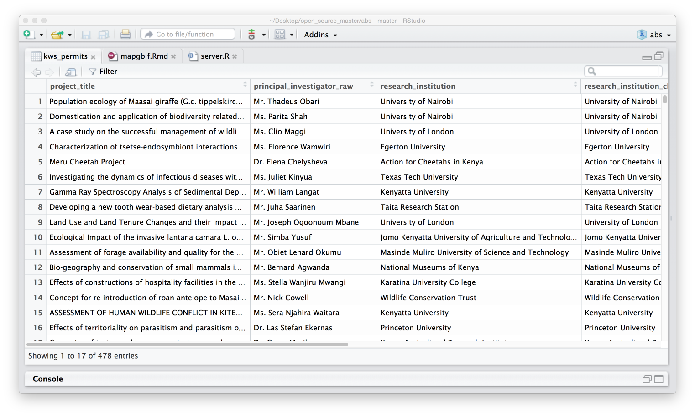
KWS Permit Data used to search for ORCID researcher ID records

Slide 36
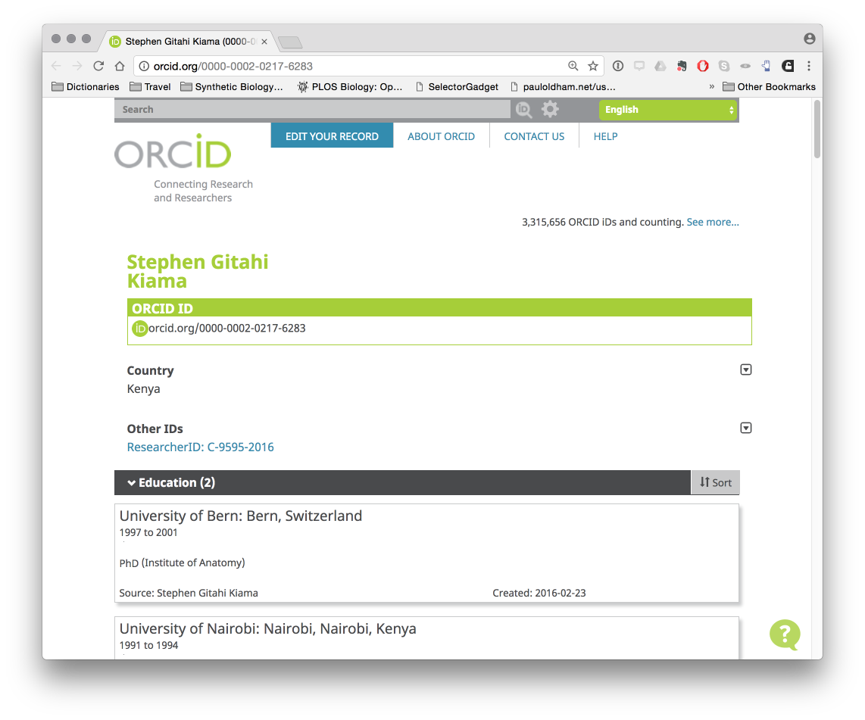
An example ORCID record for a KWS permit holder

Slide 37
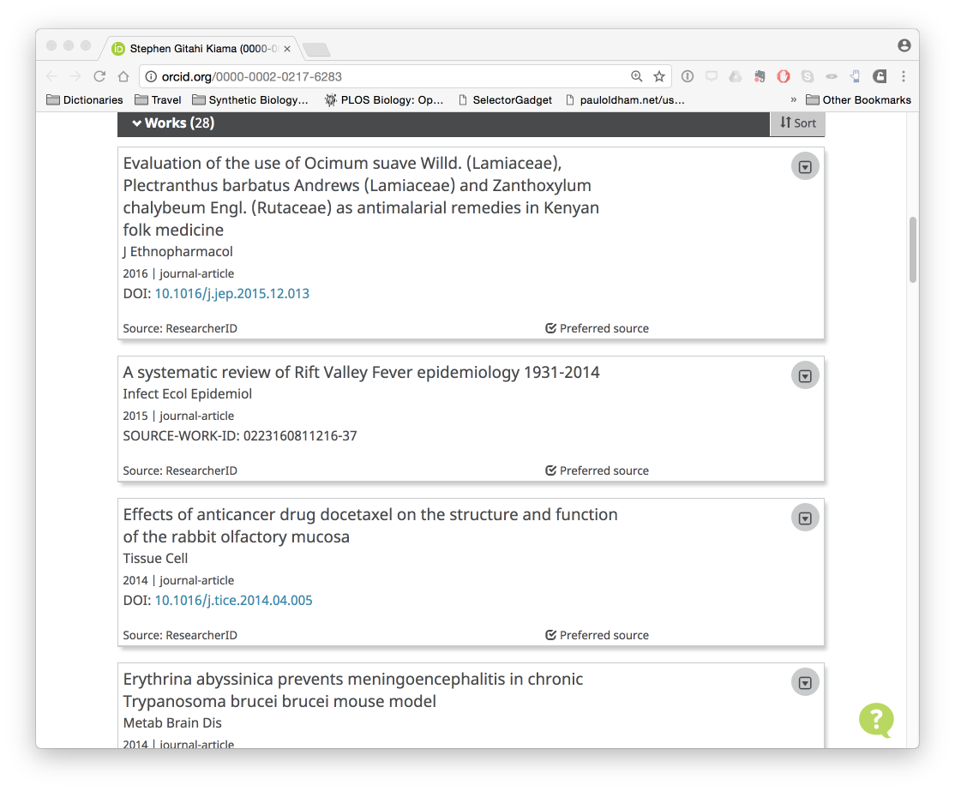
ORCID provides access to publication data for a permit holder

Slide 38
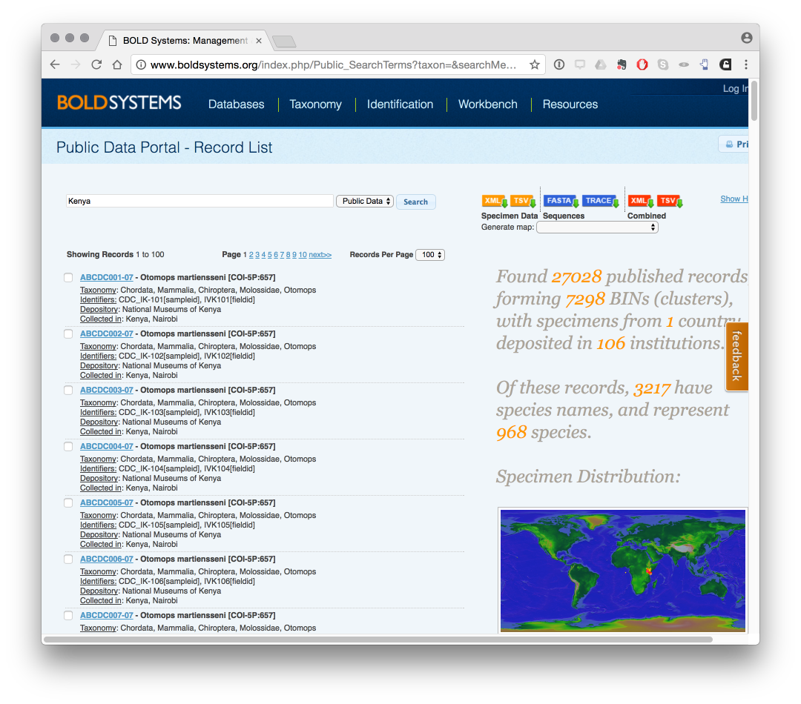
Digital Sequence Information about Kenya from the Barcode of Life Database

Slide 39
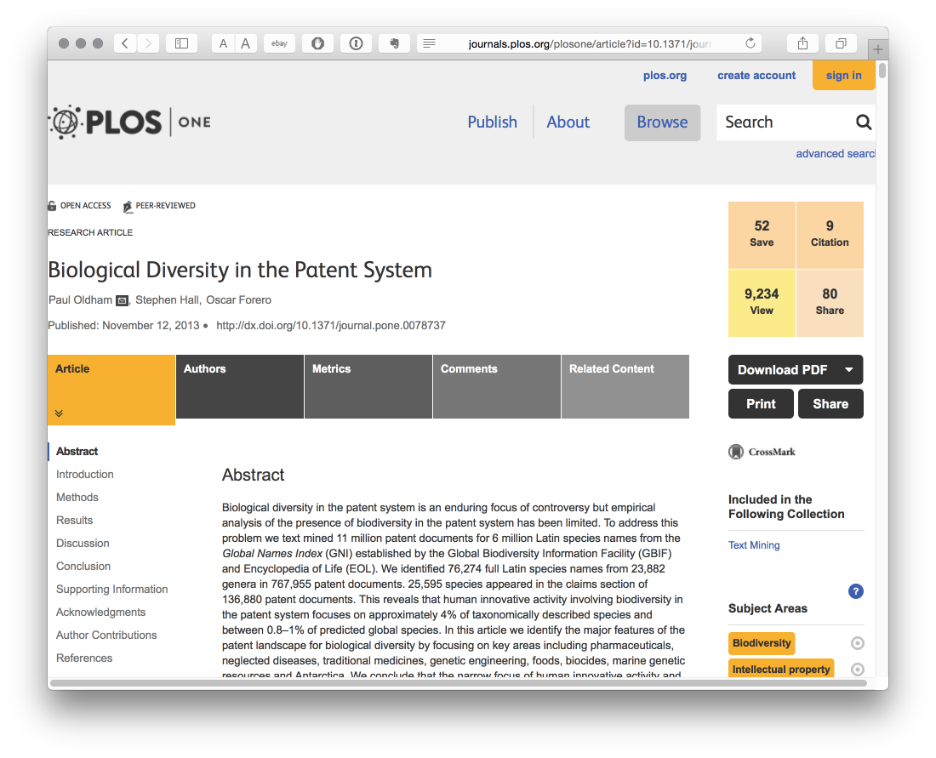
Identifying Biodiversity in Patents using Text Mining
http://journals.plos.org/plosone/article?id=10.1371/journal.pone.0078737

Slide 40
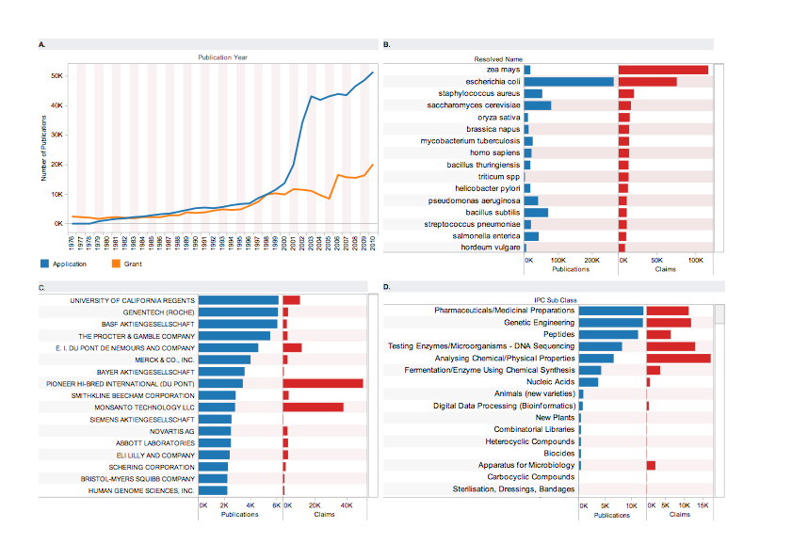
Oldham, Hall & Forero (2013) ‘Biological Diversity in the Patent System’. PLOS One.

Slide 41
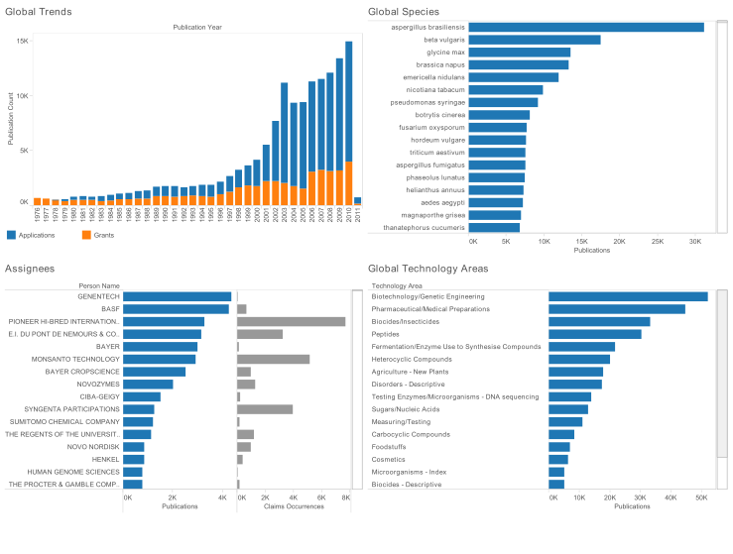
Kenya Patent Activity for All Species Recorded in Kenya

Slide 42
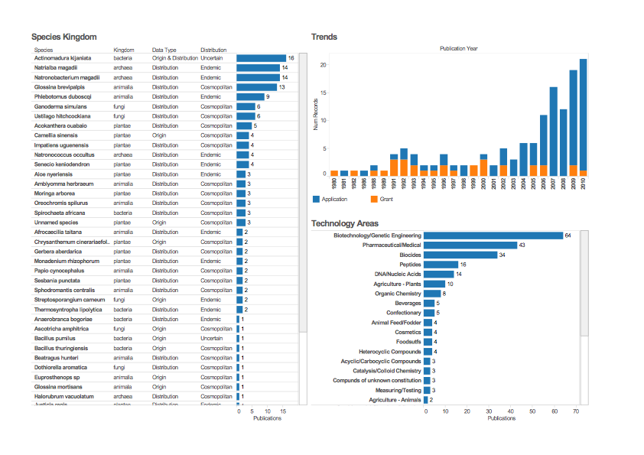
Patent Activity for Species specifically linked to Kenya

Slide 43
Conclusions
A shared system will make life easier for permit authorities and make life easier for applicants.
A straightforward electronic system will attract researchers put off by the complexities and delays involved with many permit systems.
The shared system will help with negotiating ABS contracts (MAT) by identifying those areas where agreement can easily be reached and focusing attention on areas where negotiation will be needed.
Permits are not enforceable in third countries but contracts are. Therefore each permit must be very clearly linked to a contract (legal expertise).
The system is key to monitoring compliance and showcasing the value of biodiversity and research in Kenya. That is a major value of the system.

Slide 44
What is Needed?
The shared system needs to work for every authority involved;
Some authorities may need to take more time to prepare could perhaps join the system later if need be;
Legal expertise will be critical in defining standard terms and conditions and legal consistency between the terms of permits and ABS contracts (consultancy anticipated);
For commercial negotiations, hard nosed commercial lawyers in Kenya should be identified;
Human capacity building, notably in programming and analytics is important and requires discussion;
The shared system could be an example to many other countries but really requires ownership by the authorities to be successful.

Slide 45
Next steps
Following this workshop the business requirement document will be finalised and then put before DGs in May;
Subject to approval, a software company will be invited to tender to build the system;
The legal component will be commissioned to establish terms and conditions and additional international legal expertise will be brought in;
The system must work for the authorities and so at each stage of development field testing will be needed so that it is fit for purpose (agile approach);
Identifying future human resource requirements is an important step.

Slide 46
Thank you

Slide 47
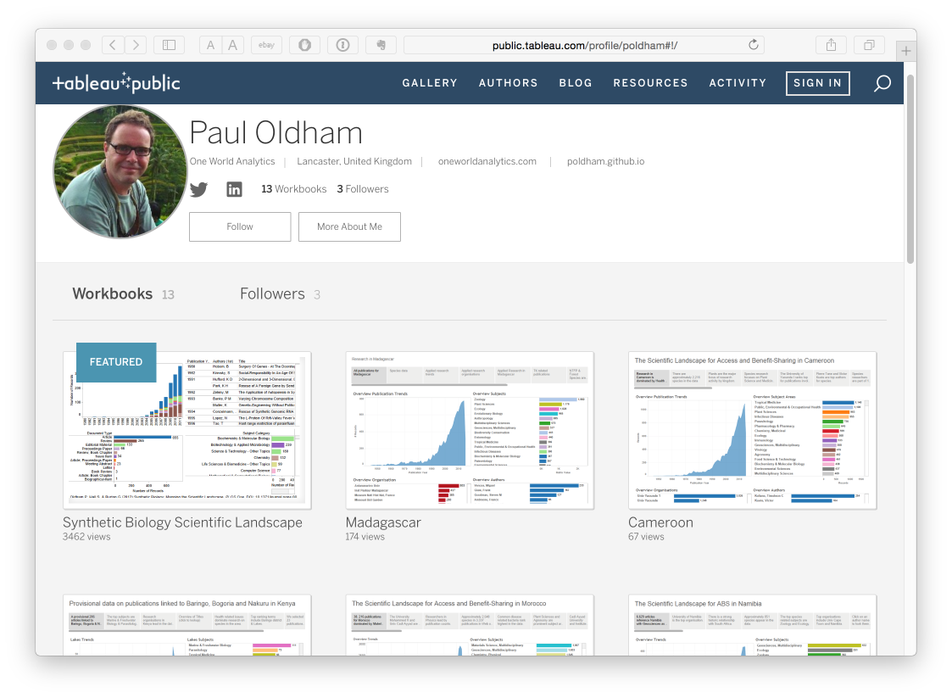
Kenya workbook available on Tableau Public
See: http://public.tableau.com/profile/poldham#!/

